Slide 1
A guide to high-frequent data assimilation with NorESM2
Ingo bethke^{1,2}
¹University of Bergen
²Bjerknes centre for climate research
EMAIL: ingo.bethke@uib.no

Slide 2
DA implementations for NorCPM
Offline (NorESM1,NorESM2)
Stop & Restart NorESM and DA seperate executables running sequent.
Disk-based communication between model and DA via modifying full restart files
Components: ocn¹², ice¹ ,lnd¹
DA freq.: monthly (slow model init. & read/write of full restarts)
Semi-online (NorESM2)
Pause & resume (hack) NorESM and DA separate executables running in parallel
Disk-based communication via reading/writing «reduced» restart files
Components: ocn, lnd,(ice,atm)
DA freq.: (sub-)daily, monthly
Online (NorESM2/2.5/3)
Pause & resume (NCAR) DA fully integrated part of NorESM and runs in same job
MPI-based communication between model and DA
Components: ocn, lnd, ice, atm
DA freq.: (sub-)daily, monthly
NEW
COMING SOON
Results on next slides!

Slide 3
Daily ocean data assimilation with NorESM2 (preliminary results)
Test using daily assim. of satellite SSTs and monthly assim. of T/S profiles
Three 10-member ensembles with NorESM2-LM
FREE (no assimilation) 800 cpu-h/sim-yr, 4 sim-yrs/d, 128 pes/member
MONTHLY (monthly SST + monthly T/S)
DAILY (daily SST + monthly T/S) daily assimilation increases cost by 50%
1996-2003 coverage (will only show results from first year)
EnKF anomaly assimilation with 1980-2010 reference period

Slide 4
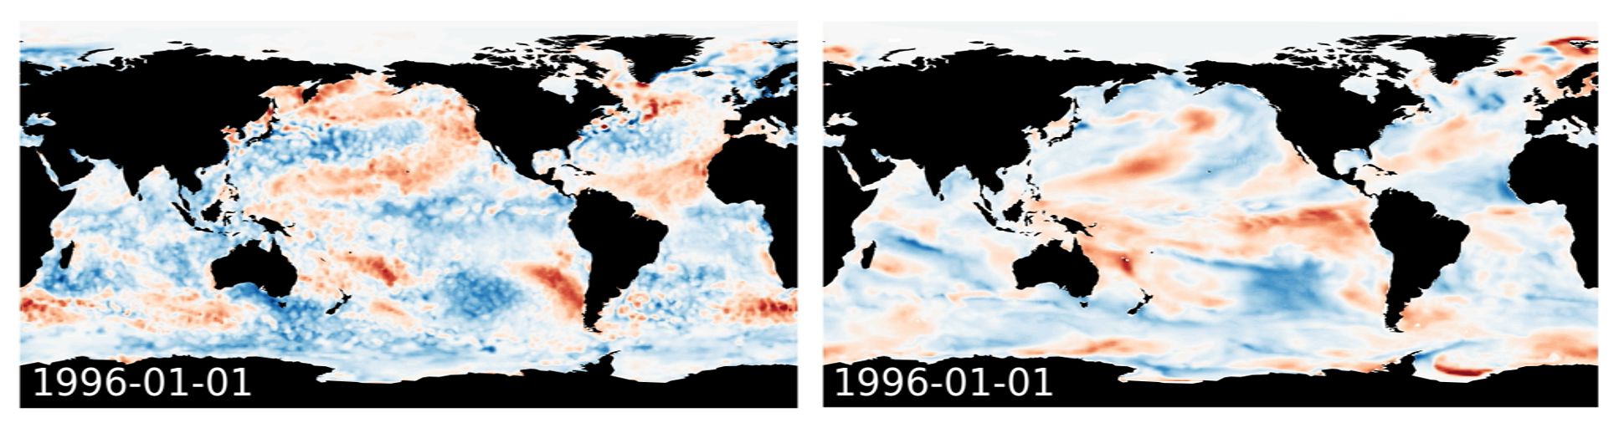
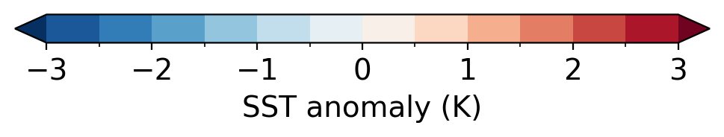
Assimilation of daily SST and monthly T/S observations – obs vs free run
OISST
FREE (member 1)

Slide 5
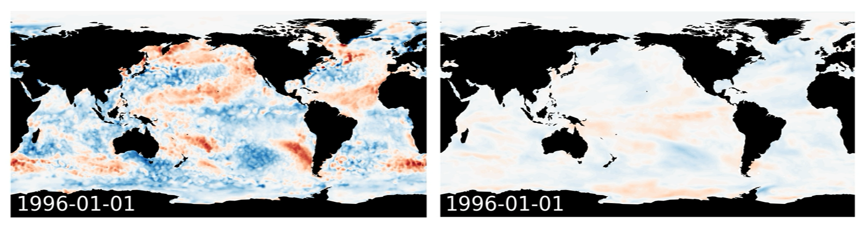
Assimilation of daily SST and monthly T/S observations – obs vs monthly assimilation
OISST
MONTHLY (ensemble mean)

Slide 6
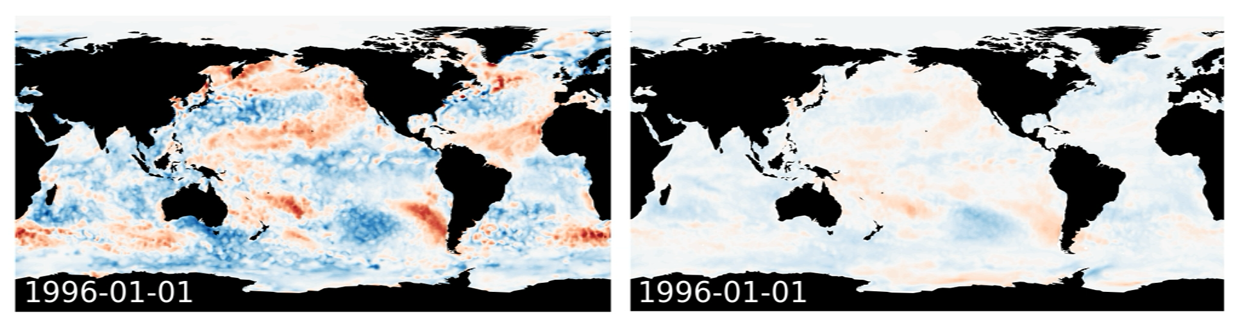
Assimilation of daily SST and monthly T/S observations – obs vs daily assimilation
OISST
DAILY (ensemble mean)

Slide 7
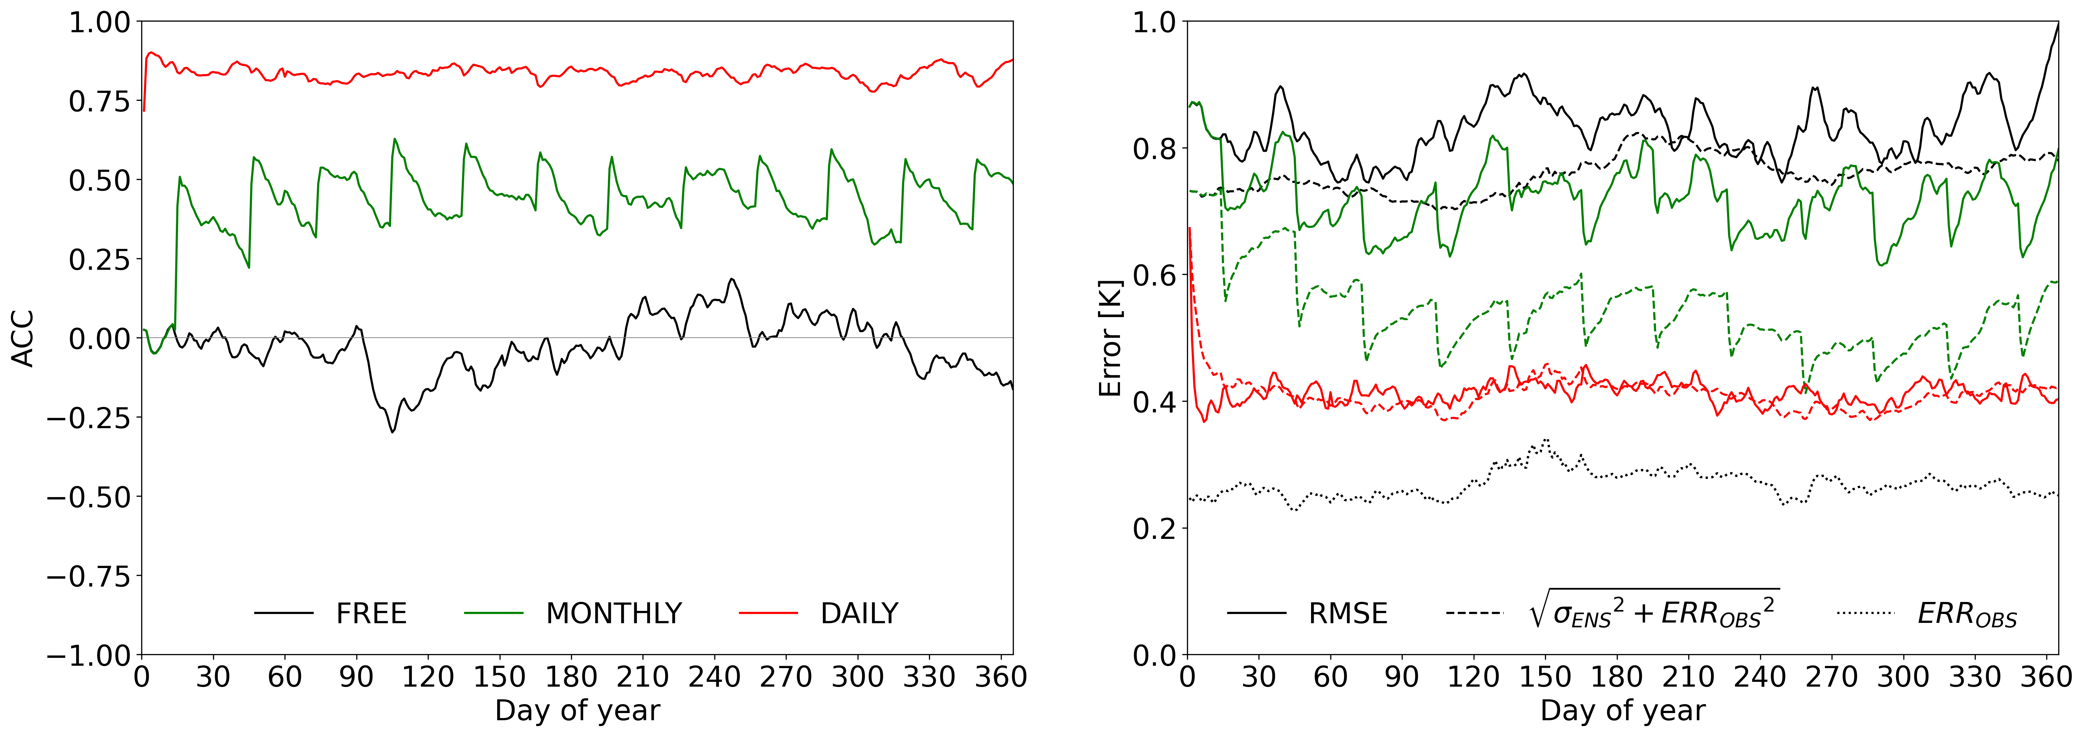
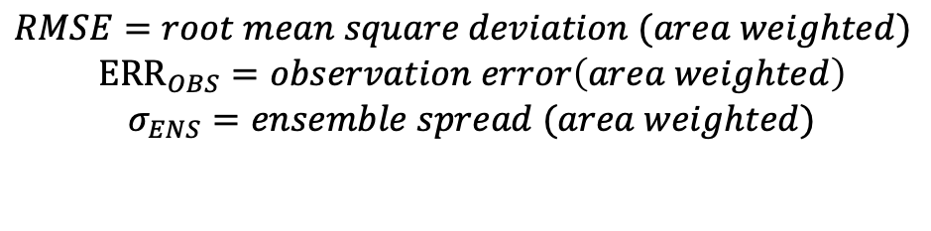
Assimilation of daily SST and monthly T/S observations – global statistics (spatial averages)
$RMSE=root mean square deviation (area weighted)$
$${ERR}_{OBS}=observation error\left(area weighted\right)$$
$$σ_{ENS}=ensemble spread (area weighted)$$
$ACC=pattern correlation (area weighted)$

Slide 8
NorCPM repository with revised structure https://github.com/NorESMhub/NorCPM
supports multiple ESM versions, assimilation schemes and experiment setup environments
multiple users can contribute to the same repository without interfering with each other's work
flexible, well-structured and organized; fully version controlled
suitable for use with NorESM1, NorESM2 and later versions
code1 (e.g. EnKF)
code2 (e.g. prep_obs)
code3 (e.g. micom_init)
…
settings1.in (e.g. analysisfields_1.in)
settings2.in (e.g. enkf.prm_1)
…
assim_build.sh
assim_step.sh
git-controlled
git-controlled?
scheme1
scheme2
myscheme
…
assim
cases
docs
logs
model
setup
tools
noresm1
noresm2
noresm3
mymodel
…
NorCPM
norcpm1-1_historical_18500101_start.sh
norcpm1-1_piControl_18500101_start.sh
norcpm1_piControl_19500101_start.sh
norcpm-cf-system1_assim_19811115_start.sh
norcpm-cf-system1_assim_19811115_continue20220915.sh
norcpm-cf-system1_assimtest_19811115_start.sh
norcpm-cf-system1_hindcast1_20230115_start.sh
setmach.sh
noresm1
noresm2
noresm3
mysetup
…
settings
create_ensemble.sh
submit_ensemble.sh
…

Slide 9
Workflow
1
2
submit_ensemble.sh <settings file>
archive_ensemble.sh <settings file>
Login node
Login node
1 task
case.st_archive.sh
Batch system (compute nodes)
run_ensemble.sh
10-40 nodes
1 node
NorESM
- pause&resume
assim_step.sh
preproc
EnKF
micom_init
fix_enkf
3
compress_ensemble.sh <settings file>
Login node
4 nodes
Batch system (compute nodes)
noresm2nc4mpi
Batch system (compute nodes)

Slide 10
Mini-tutorial for performing a daily assimilation experiment using NorESM2-LM
Install NorCPM in the nn9039k project space
mkdir -p /cluster/projects/nn9039k/people/$USER
cd /cluster/projects/nn9039k/people/$USER
git clone ssh://git@github.com/NorESMhub/NorCPM.git NorCPM
(or “git clone https://github.com/NorESMhub/NorCPM.git NorCPM”)
Install NorESM2
cd /cluster/projects/nn9039k/people/$USER/NorCPM/setup/noresm2
./install_noresm2.sh
Set up a NorESM2-LM assimilation test experiment with 10 members
./create_ensemble.sh settings/noresm2-lm_odaday_19960101.sh
Submit experiment
./submit_ensemble.sh settings/noresm2-lm_odaday_19960101.sh

Slide 11
Customizing NorESM2 (cpu settings, source code, diagnostic output)
NorCPM/setup/noresm2/user_mods contains NorESM2 customization folders
noresm2-lm_128pes
noresm2-lm_640pes
noresm2-lm_clmda_128pes
noresm2-lmesm_128pes
Each customization folder countains
env_mach_pes.xml: specifies pes/cpu settings
SourceMods: customized source code should be placed there
user_nl_*: user namelists used to customize diagnostic output
Can create new customization folder and point to it in experiment settings file (next slides)

Slide 12
Settings file – experiment and job settings
# experiment settings
: ${EXPERIMENT:=noresm2-lm_odaday} # case prefix, not including _YYYYMMDD_memXX suffix
: ${MEMBER1:=1} # first member
: ${ENSSIZE:=10} # number of members
: ${COMPSET:=NHISTfrc2} # need to switch compset at start of 2015
: ${USER_MODS_DIR:=$SETUPROOT/user_mods/noresm2-lm_128pes}
: ${RES:=f19_tn14}
: ${START_DATE:=1996-01-01} # YYYY-MM-DD
# job settings
: ${STOP_OPTION:=nyears} # units for run length specification STOP_N
: ${STOP_N:=1} # run continuesly for this length
: ${RESTART:=7} # restart this many times
: ${WALLTIME:='96:00:00'} # for debugging use '00:59:00 –qos=devel'
: ${ACCOUNT:=nn9039k}
: ${MAX_PARALLEL_STARCHIVE:=30}

Slide 13
Settings file – initialisation option 1: guessed reference case names
# initialisation settings – ref. cases guessed from REF_CASE_PREFIX, REF_CASE_SUFFIX_MEMBER1
: ${RUN_TYPE:=branch}
: ${REF_CASE_PREFIX:=noresm_ctl_19700101_19700101}
: ${REF_CASE_SUFFIX_MEMBER1:=_mem01}
: ${REF_PATH_LOCAL:=$INPUTDATA/ccsm4_init/$REF_CASE_PREFIX}
: ${REF_DATE:=1996-01-01}
reference case names guessed from REF_CASE_PREFIX and REF_CASE_SUFFIX_MEMBER1
number of references cases >= ENSSIZE
RUN_TYPE can be either “branch” or “hybrid”
available ref dates for NorESM2-LM: 1975, 1985, 1996, 2015

Slide 14
Settings file – initialisation option 2: explicitely specified reference case names
# initialisation settings
: ${RUN_TYPE:=hybrid}
: ${REF_CASE_LIST:='noresm_ctl_19700101_19700101_mem01 noresm_ctl_19700101_19700101_mem02 noresm_ctl_19700101_19700101_mem03 noresm_ctl_19700101_19700101_mem04 noresm_ctl_19700101_19700101_mem05 noresm_ctl_19700101_19700101_mem06 noresm_ctl_19700101_19700101_mem07 noresm_ctl_19700101_19700101_mem08 noresm_ctl_19700101_19700101_mem09 noresm_ctl_19700101_19700101_mem10'}
: ${REF_PATH_LOCAL:=/cluster/work/users/$USER/restarts}
: ${REF_DATE:=$START_DATE}
: ${ADD_PERTURBATION:=1} # only for RUN_TYPE=hybrid
reference case names specified with REF_CASE_LIST
reference cases cycled if their number is < ENSSIZE
ADD_PERTURBATION=1 adds atmospheric perturbation if RUN_TYPE=1

Slide 15
Settings file – initialisation option 3: single reference case, multiple reference dates
# initialisation settings
: ${RUN_TYPE:=hybrid}
: ${REF_CASE:=N1850frc2_f09_tn14_20191113}
: ${REF_PATH_LOCAL:=$INPUTDATA/ccsm4_init/$REF_CASE}
: ${REF_DATE_LIST:='1500-01-01 1505-01-01 1510-01-01 1515-01-01'}
: ${ADD_PERTURBATION:=1} # only for RUN_TYPE=hybrid
reference case specified with REF_CASE or REF_CASE_LIST
references dates specified with REF_DATE_LIST
references dates cycled if number of dates < ENSSIZE
RUN_TYPE must be “hybrid”

Slide 16
Settings file – assimilation
# assimilation settings
: ${ASSIMROOT:=$SETUPROOT/../../assim/enkf_noresm2_oda}
: ${MEAN_MOD_DIR:=$INPUTDATA_ASSIM/enkf/$RES/NorESM2-LM-CMIP6}
: ${NTASKS_DA:=128}
: ${NTASKS_ENKF:=108}
: ${OCNGRIDFILE:=$INPUTDATA/ocn/blom/grid/grid_tnx1v4_20170622.nc}
: ${OBSLIST:='TEM SAL SST'}
: ${PRODUCERLIST:='EN422 EN422 NOAA'}
: ${FREQUENCYLIST:='MONTH MONTH DAY'}
: ${REF_PERIODLIST:='1980-2010 1980-2010 1980-2010'}
: ${COMBINE_ASSIM:='0 0 1'}

Slide 17
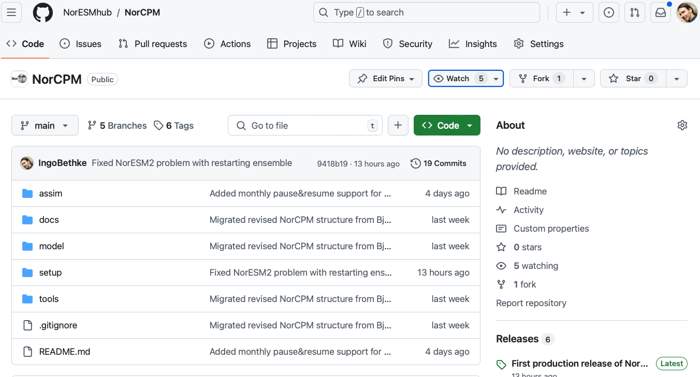
How to contribute to NorCPM
Step 1: create fork NorESMhub/NorCPM in your personal github space

Slide 18
How to contribute to NorCPM
Step 2: log on to Betzy and clone NorCPM from your personal github space
mkdir -p /cluster/projects/nn9039k/people/$USER
cd /cluster/projects/nn9039k/people/$USER
git clone ssh://git@github.com/<my github user>/NorCPM.git NorCPM
IMPORTANT: Before you can use ”ssh://git@github.com” form Betzy, you need to create a public ssh-key on Betzy and upload the key to your github profile.

Slide 19
How to contribute to NorCPM
Step 3: apply changes to your local NorCPM clone on Betzy

Slide 20
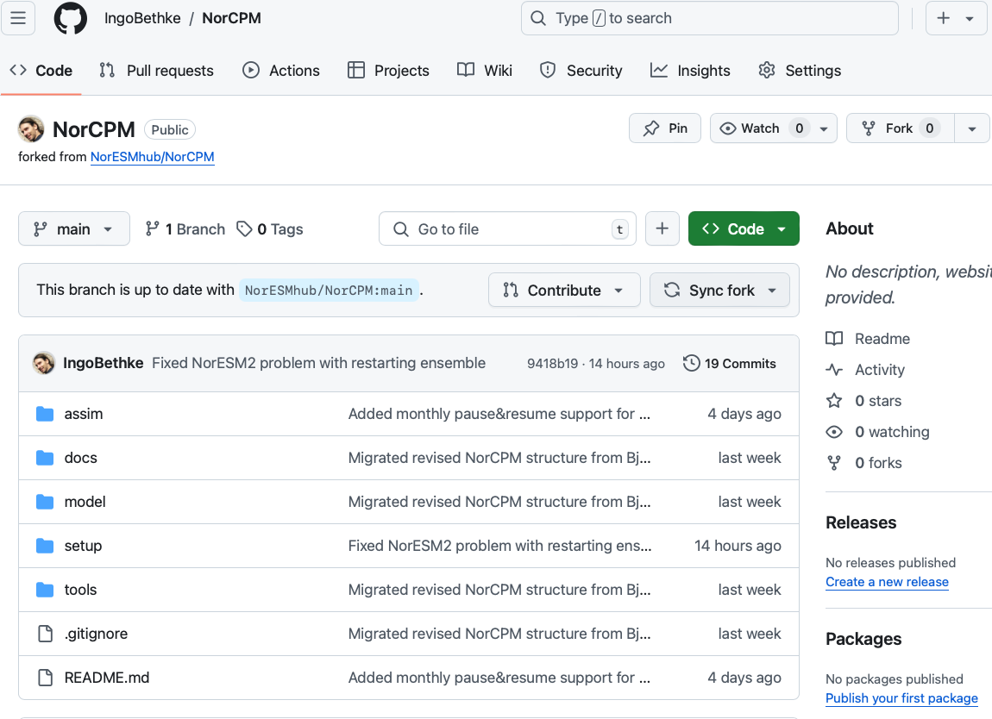
How to contribute to NorCPM
Step 4: synchronize your fork with the latest NorESMhub/NorCPM state

Slide 21
How to contribute to NorCPM
Step 5: synchronize your local NorCPM clone with your github fork
git pull

Slide 22
How to contribute to NorCPM
Step 6: commit your changes to your local NorCPM clone
git add .
git status
git commit –m 'my commit message'

Slide 23
How to contribute to NorCPM
Step 8: push the changes from your local NorCPM clone to your github fork
git push

Slide 24
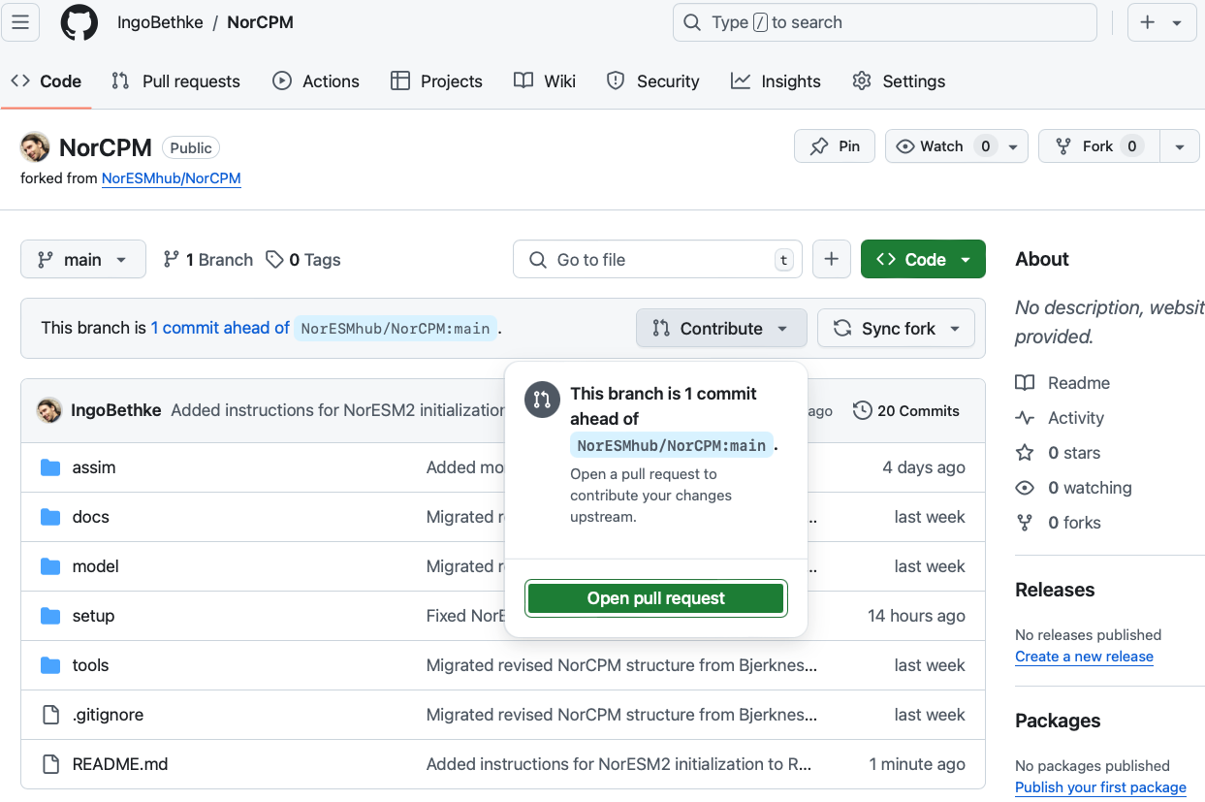
How to contribute to NorCPM
Step 9: issue pull request for applying changes from your fork to NorESMhub/NorCPM

Slide 25
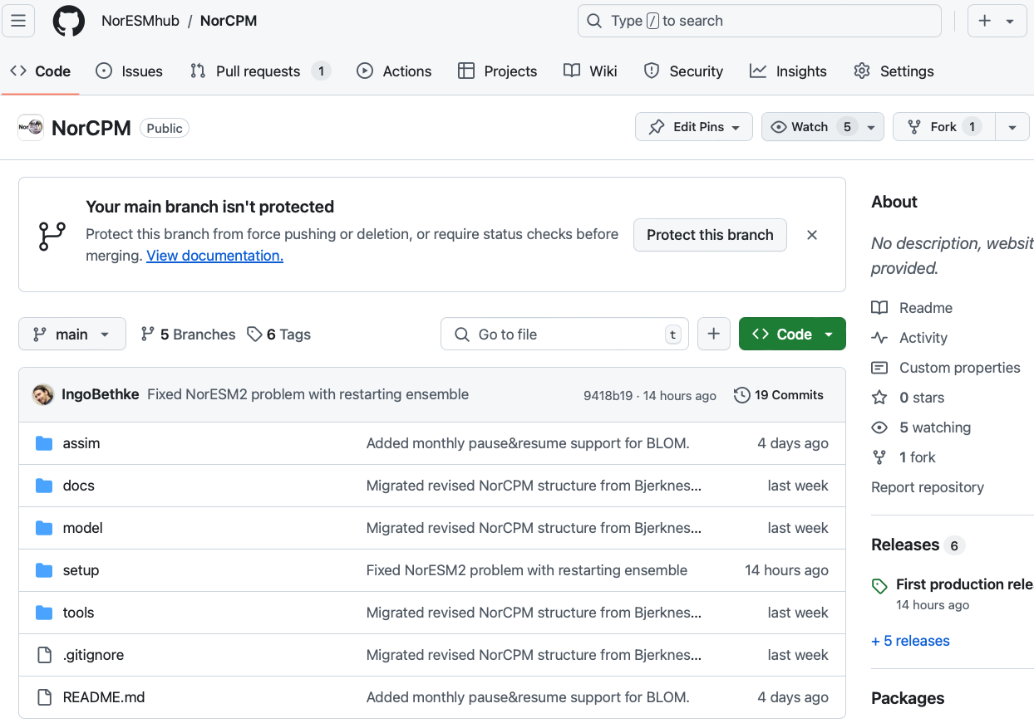
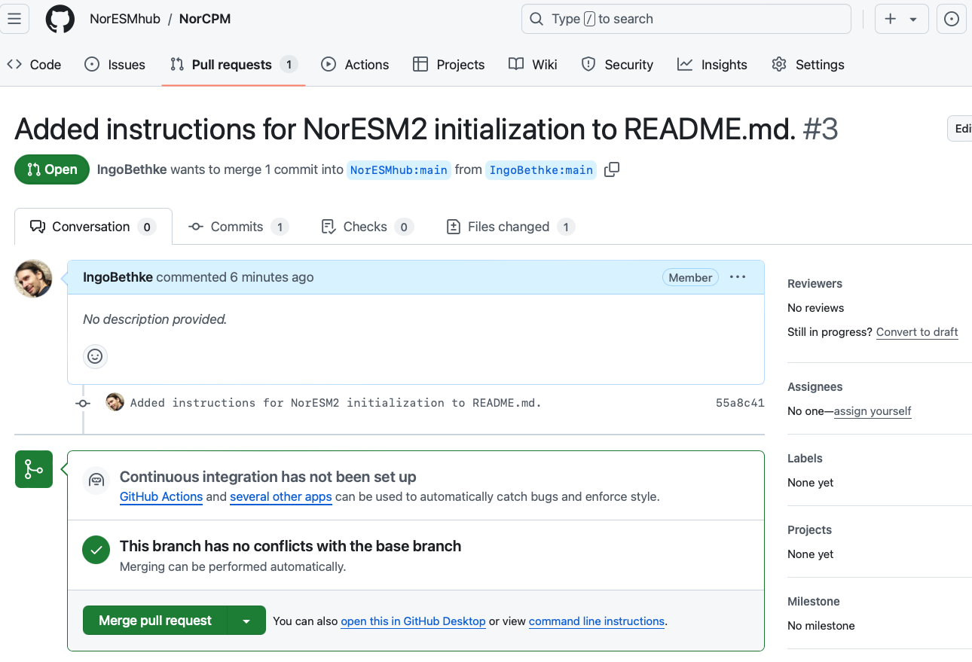
How to contribute to NorCPM
Step 10: merge pull request (only for maintainers)

Slide 26
Current status
ready-to-use NorESM2 setup with daily SST assimilation and monthly T/S assimilation
initial conditions available for 10 members for years 1975, 1985, 1996, 2015
must switch from historical to scenario compset in 2015
Coming soon
more restart members and restart dates for NorESM2-LM
combined historical-scenario compset that allows running 1850-2100
how-to-guide for contributing via github
«full-online» assimilation setup developed by Ping-Gin

